Slide 1
UNIT-IV
Generalized Linear Model:
Time Series Analysis

Slide 2
Contents
Generalized Linear Model: link functions such as Poisson, binomial, inverse binomial, inverse Gaussian, Gamma.
Non-Linear Regression (NLS): Linearization transforms, their uses & limitations, examination of non-linearity, initial estimates, iterative procedures for NLS, grid search, Newton-Raphson, steepest descent, Marquardt’s methods.
Time Series Analysis: Auto-Covariance, Auto-correlation and their properties.
Exploratory time series analysis, Test for trend and seasonality, Exponential and moving average smoothing, Holt – Winter smoothing, forecasting based on smoothing.

Slide 3

Generalized Linear Model
Refer to class notes (PDF + Hand-Written notes ) for Normal, Poisson, and Binomial distributions (Practice Problems + Formulas+ Conditions)
GAMMA Distribution
Gamma distribution is a type of probability distribution that is defined for non-negative real numbers and is used to model the waiting time until a specific event occurs in a Poisson process or the time between events in a Poisson process.
Gamma distribution can take on different forms, making it suitable for a range of applications. From engineering and finance to Bayesian statistics and queuing theory, the Gamma distribution plays a crucial role in understanding and predicting the behavior of processes governed by random events.
The gamma function depicted by Γ(α), is an extension of the factorial function. The values of the gamma function for non-integer arguments generally cannot be expressed in simple, closed forms. The gamma distribution is written as Gamma (α,λ)

Slide 4

Gamma Distribution Formula - Probability Density Function (PDF)
The Gamma Distribution is defined by two parameters: the shape parameter k (also denoted as α and the scale parameter θ (also denoted as ββ. The probability density function (PDF) of the Gamma distribution is given by:
Gamma Distribution Mean and Variance
The mean of a random variable is a measure of its central tendency while variance measures the spread or dispersion of a random variable. It tells us how much the values of a random variable deviate from its mean.
1. The mean of the Gamma distribution is μ=α/λ
2. The variance of Gamma Distribution is σ2=α/λ2

Slide 5
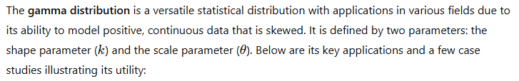
Case Study: Rainfall Analysis Using Gamma Distribution
Context
Rainfall variability significantly impacts agriculture, water resource management, and disaster preparedness. Understanding and modeling rainfall patterns are essential for planning and mitigation strategies. This case study focuses on how the gamma distribution is applied to model monthly rainfall data for predictive purposes.
Study Area
The study was conducted in a semi-arid region of India prone to high rainfall variability.
Monthly rainfall data were collected from meteorological stations over 30 years (1990–2020).
Objective
To model the distribution of monthly rainfall using the gamma distribution.
To predict extreme rainfall events and assess the probability of drought or floods.

Slide 6
Gamma distribution
  Methodology
  Data Collection and Preprocessing:
  Monthly rainfall data were collected from meteorological records.
  Data were cleaned to remove outliers and fill missing values using interpolation techniques.
  Fitting the Gamma Distribution:
  The gamma distribution was chosen due to its flexibility in modeling skewed data.
  Parameters (k, θ) were estimated using the method of moments and maximum likelihood estimation (MLE).
  Goodness-of-fit tests (e.g., Kolmogorov-Smirnov and Chi-square tests) validated the fit.
  Probability Analysis:
  Computed probabilities of rainfall exceeding or falling below specific thresholds.
  Assessed the likelihood of extreme rainfall events (e.g., more than 200 mm in a month).

Slide 7
Results
1. Model Fit:
  The gamma distribution provided an excellent fit to the rainfall data, as evidenced by low AIC and BIC scores.
  Parameters estimated: k=2.8 , θ=30.5
  2. Insights from Probability Analysis:
  Probability of monthly rainfall exceeding 150 mm: 20%.
  Probability of less than 50 mm of rainfall (drought condition): 15%.
  3. Comparison:
  The gamma distribution outperformed exponential and log-normal models in capturing the skewness of the rainfall data.
4. Extreme Events:
  Identified years with the highest and lowest rainfall probabilities.
  Probability of extreme rainfall events was estimated to inform flood mitigation strategies.

Slide 8
Time Series Analysis
Time series analysis is a field of data analysis that involves studying data points collected or recorded sequentially over time.
Time series data is common in many fields, such as finance (stock prices), economics (GDP, inflation), meteorology (temperature, precipitation), and healthcare (patient vital signs)
Key Concepts:
Trend: The long-term direction or movement in the data, such as an upward or downward trend.
Seasonality: Repeating patterns or cycles in the data that occur at regular intervals, such as daily, weekly, or yearly.
Cyclical Patterns: Fluctuations in the data that occur over irregular periods, often due to economic or business cycles.
Stationarity: A time series is stationary if its statistical properties (mean, variance) do not change over time. Stationarity is important for certain types of analysis and modelling.

Slide 9
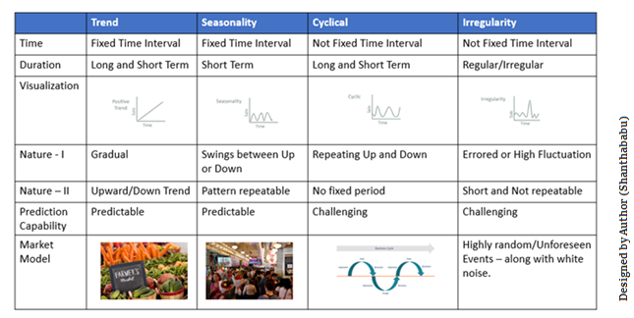

Slide 10
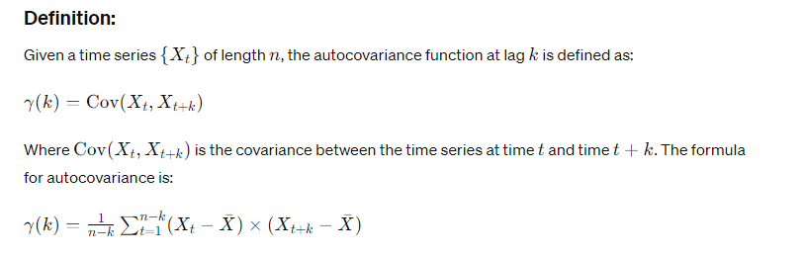
Auto - Covariance
Auto-covariance is a measure of how the values of a time series are correlated with itself at different time lags.
It is an important concept in time series analysis because it helps in understanding the structure and behavior of the series, especially the presence of serial correlation (dependencies between different time points).

Slide 11
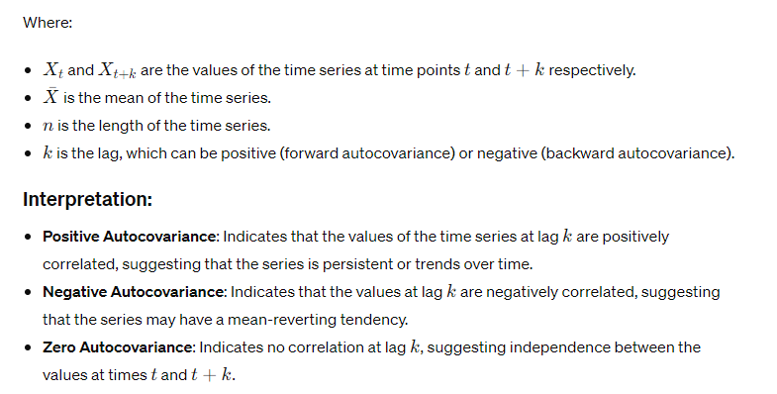

Slide 12
Applications
Modeling Time Series: Auto-covariance helps identify patterns of dependence in a time series, which can inform the selection of models such as autoregressive (AR) models, moving average (MA) models, or more complex models like ARMA and ARIMA.
Predictive Analysis: Understanding auto-covariance helps in forecasting future values of the time series.
Testing Stationarity: Auto-covariance functions can be used to test whether a time series is stationary or not.

Slide 13
Auto-correlation and their properties
Autocorrelation, also known as serial correlation, is a measure of the correlation between a time series and a lagged version of itself.
It quantifies the relationship between values at different points in time and is a key concept in time series analysis.
Autocorrelation is closely related to auto-covariance, but while auto-covariance measures the covariance between time series values, autocorrelation standardizes the measure by dividing it by the variance of the series.

Slide 14
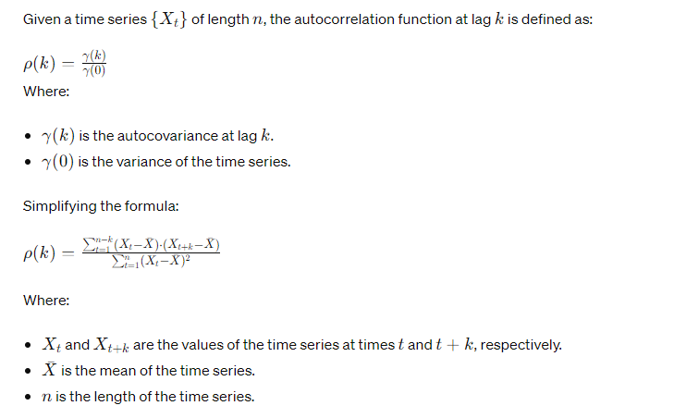
Definition

Slide 15
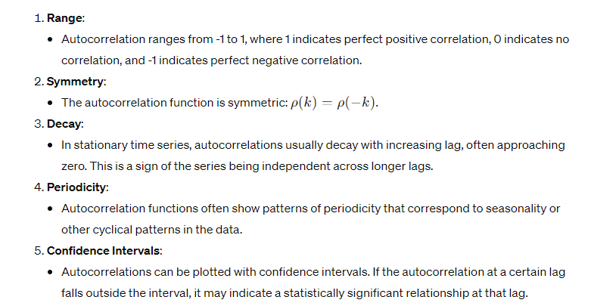
Properties of Autocorrelation

Slide 16
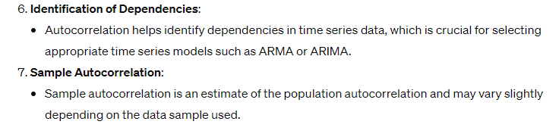

Slide 17
Exploratory time series analysis
Exploratory time series analysis (ETSA) is the initial phase of analyzing time series data to understand its structure, identify patterns, and uncover potential relationships.
This process helps guide the selection of appropriate models and forecasting methods, as well as providing insights into the underlying processes generating the data.
Objectives of Exploratory Time Series Analysis:
Understand the data's behavior: Identify trends, seasonality, and cyclical patterns.
Assess stationarity: Determine whether the data exhibits constant statistical properties over time.
Detect potential outliers: Identify unusual values that may impact analysis.
Identify dependencies: Examine autocorrelation and other relationships in the data.
Guide model selection: Use insights from the analysis to choose appropriate models for forecasting.

Slide 18
Steps in Exploratory Time Series Analysis
1.Data Visualization:
Time Series Plot: Plot the raw data over time to observe trends, seasonality, and overall patterns.
Histogram and Density Plot: Examine the distribution of the data.
Box Plot: Assess data distribution across different periods (e.g., by year or month).
2.Descriptive Statistics:
Calculate summary statistics such as mean, median, variance, standard deviation, skewness, and kurtosis.
Examine changes in these statistics over time.
3.Trend and Seasonality Analysis:
Decomposition: Separate the series into trend, seasonal, and residual components using decomposition methods (e.g., additive or multiplicative).
Moving Averages: Apply moving averages to smooth the data and identify underlying trends.

Slide 19
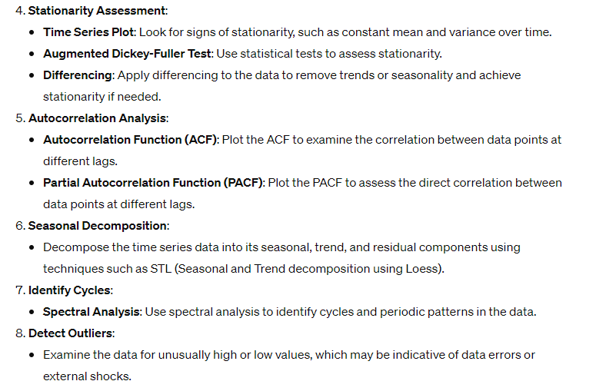

Slide 20
Tools for Exploratory Time Series Analysis:
Pandas: Provides time series handling and visualization tools.
Matplotlib and Seaborn: Libraries for data visualization.
Statsmodels: Offers statistical models, including time series models, and tools for time series decomposition and analysis.

Slide 21
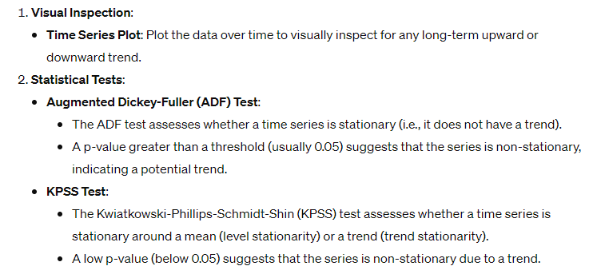
Test for trend and seasonality
Testing for trend and seasonality is an important part of exploratory time series analysis because it helps to identify whether the data has a long-term trend (upward or downward) or repeating patterns at regular intervals (seasonality).
Identifying trends and seasonality can guide the selection of appropriate models and forecasting methods.
Testing for Trend

Slide 22
Exponential and moving Average smoothing
Exponential smoothing and moving average smoothing are two popular techniques for analyzing time series data and forecasting future values.
They are both used to smooth out fluctuations in data to identify trends and patterns.
Exponential Smoothing:
Exponential smoothing is a weighted average method where the weights decrease exponentially as you go back in time.
It is a more sophisticated method than moving average smoothing and is widely used in time series analysis and forecasting.

Slide 23
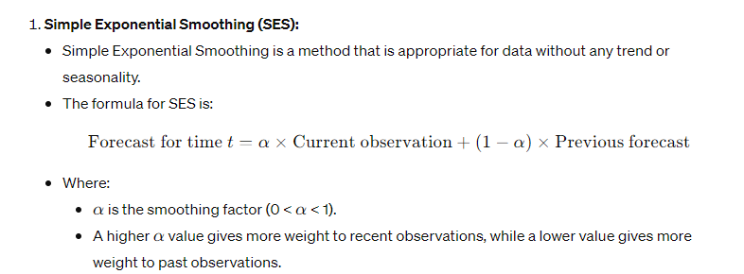

Slide 24
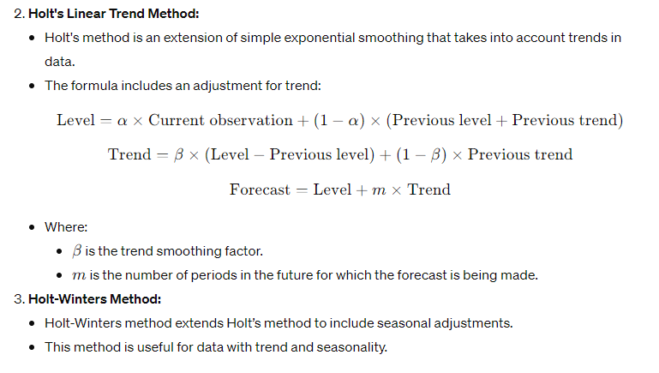

Slide 25
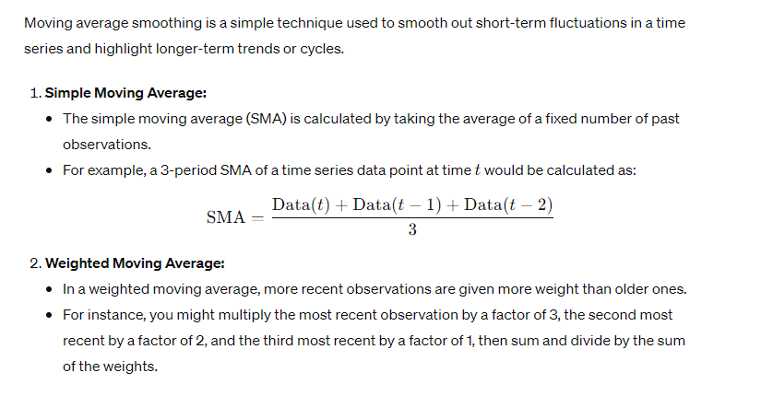
Moving Average Smoothing

Slide 26
Both techniques can be helpful in time series analysis depending on the specific context of the data.
Exponential smoothing is typically preferred for forecasting because it adjusts more quickly to changes in the data, whereas moving average smoothing is useful for highlighting broader trends in the data.

Slide 27
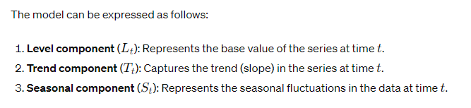
Holt – Winter smoothing
Holt-Winters smoothing, also known as Holt-Winters exponential smoothing, is an extension of Holt's linear trend method that includes seasonality in the model.
It is particularly useful for time series data that exhibits both a trend and seasonality.
Holt-Winters smoothing uses three parameters to account for the level, trend, and seasonal components in the data.

Slide 28
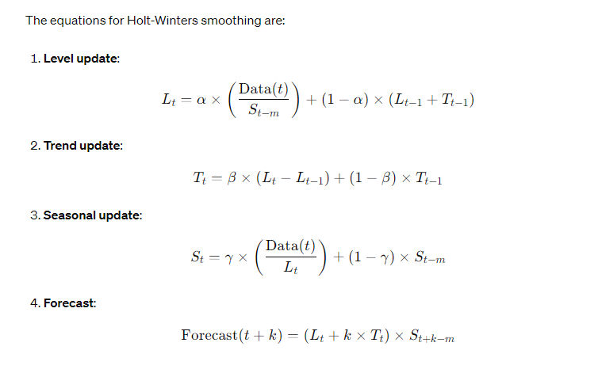
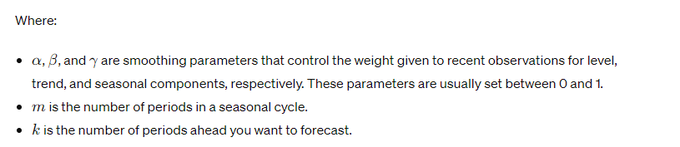

Slide 29
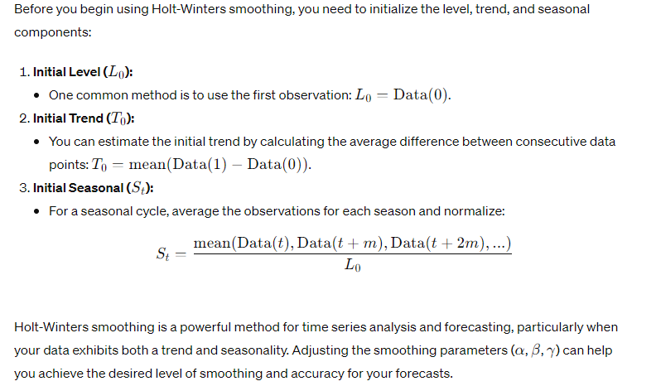
Initializing Parameters

Slide 30
Forecasting based on smoothing
Forecasting based on smoothing techniques involves using the smoothed values of a time series to predict future values.
There are different smoothing methods available for forecasting, such as exponential smoothing and moving average smoothing.
These methods help to filter out noise and emphasize trends and patterns in the data, allowing for more accurate forecasts.

Slide 31
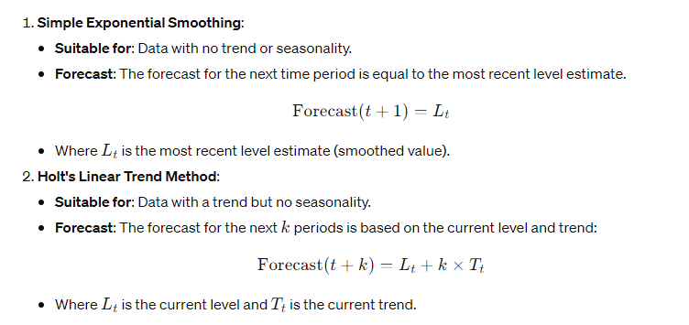
Exponential Smoothing for Forecasting
Exponential smoothing is widely used for time series forecasting due to its ability to capture trends and seasonality in the data.

Slide 32
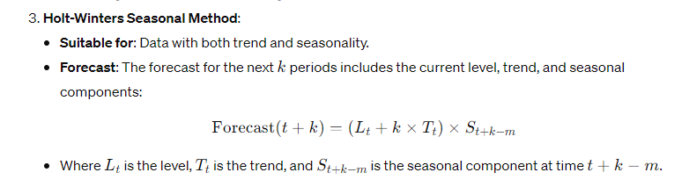

Slide 33
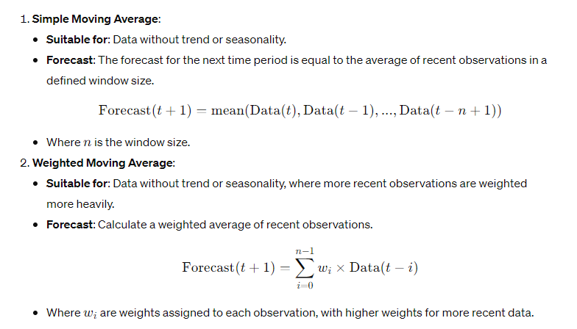
Moving Average Smoothing for Forecasting
Moving average smoothing is a simpler approach that uses averages of recent data points to create forecasts.

Slide 34
Iterative procedures for NLS
Nonlinear least squares (NLS) is a form of regression used to fit a nonlinear model to data. The model is represented by a function with parameters that need to be estimated to minimize the sum of squared differences between the observed and predicted values.
In many cases, solving a nonlinear least squares problem requires using iterative procedures because there may not be an analytical solution. Iterative optimization algorithms are used to find the optimal parameters that minimize the sum of squared errors.

Slide 35
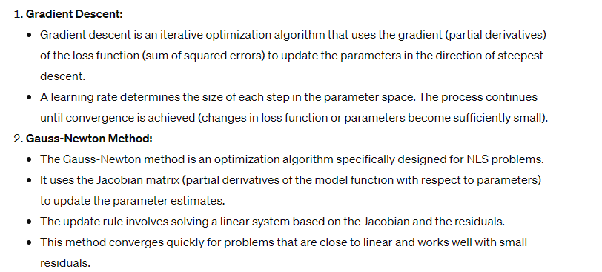
Iterative Procedures for Nonlinear Least Squares:

Slide 36
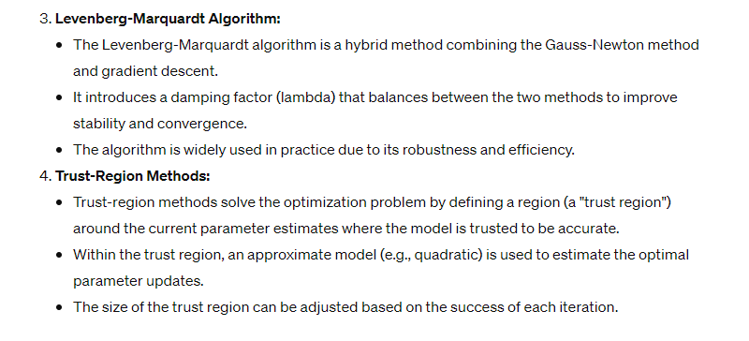

Slide 37
Grid search
In nonlinear regression, grid search is a common method for hyperparameter tuning.
Nonlinear regression involves fitting a model to data where the relationship between the input features and the target variable is nonlinear.
The goal of grid search is to find the best combination of hyperparameters that optimize the model's performance.
// how to apply grid search in nonlinear regression://
Step 1: Define the Nonlinear Regression Model
First, you need to define the nonlinear regression model you want to use. For instance, this could be a polynomial regression model, a decision tree, a neural network, or other models that can handle nonlinear relationships.
Step 2: Define the Hyperparameters to Tune
Identify the hyperparameters of the model that you want to tune. These could include:
Polynomial Regression: The degree of the polynomial.
Decision Tree: The maximum depth, minimum samples split, or leaf.
Neural Network: The learning rate, number of layers, or neurons per layer.

Slide 38
Step 3: Create a Parameter Grid
Create a dictionary containing the hyperparameters and their possible values. For each hyperparameter, provide a list of values that you want to test.
For example, if you are using a polynomial regression model, you might want to test different degrees:

Slide 39
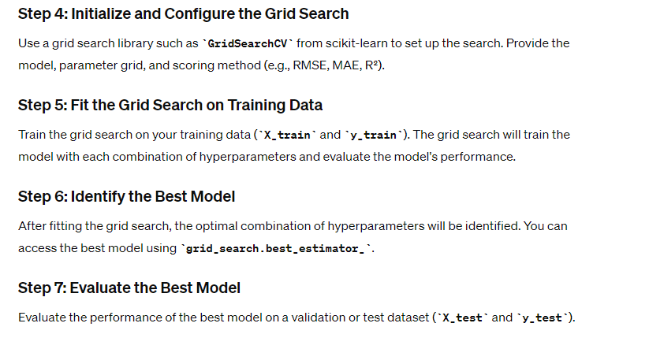

Slide 40
In nonlinear regression, the choice of hyperparameters and the complexity of the model can significantly affect performance, so grid search is an important tool to optimize your model.

Slide 41
Newton Raphson Method
The Newton-Raphson method which is also known as Newton’s method, is an iterative numerical method used to find the roots of a real-valued function.
This formula is named after Sir Isaac Newton and Joseph Raphson, as they independently contributed to its development.
Newton Raphson Method or Newton’s Method is an algorithm to approximate the roots of zeros of the real-valued functions, using guess for the first iteration (x0) and then approximating the next iteration(x1) which is close to roots, using the following formula.
x1 = x0 – f(x0)/f'(x0)

Slide 42
where,
x0 is the initial value of x,
f(x0) is the value of the equation at initial value, and
f'(x0) is the value of the first order derivative of the equation or function at the initial value x0.
Note: f'(x0) should not be zero else the fraction part of the formula will change to infinity which means f(x) should not be a constant function.

Slide 43
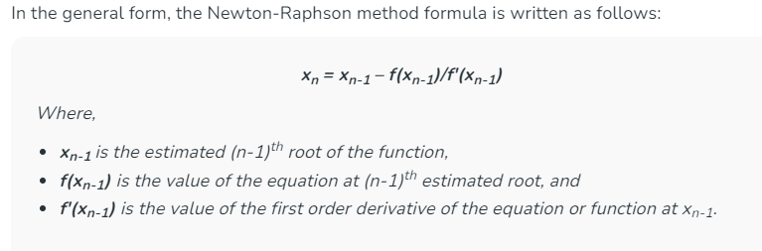
Newton Raphson Method Formula

Slide 44
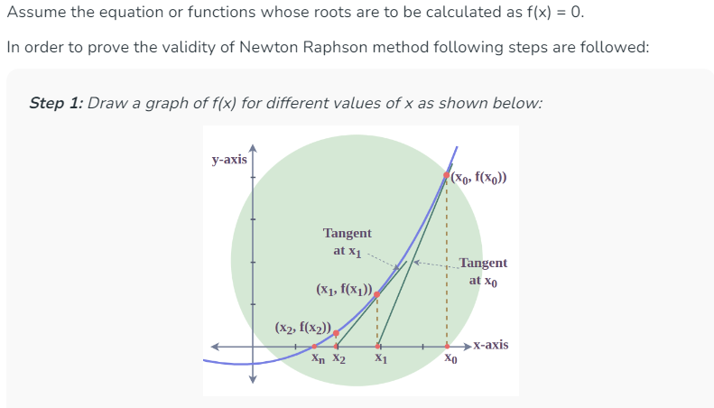
Newton Raphson Method Calculation

Slide 45
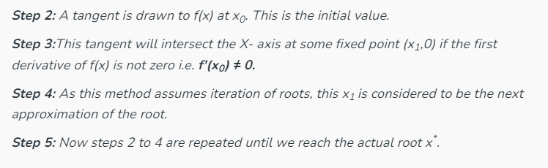

Slide 46
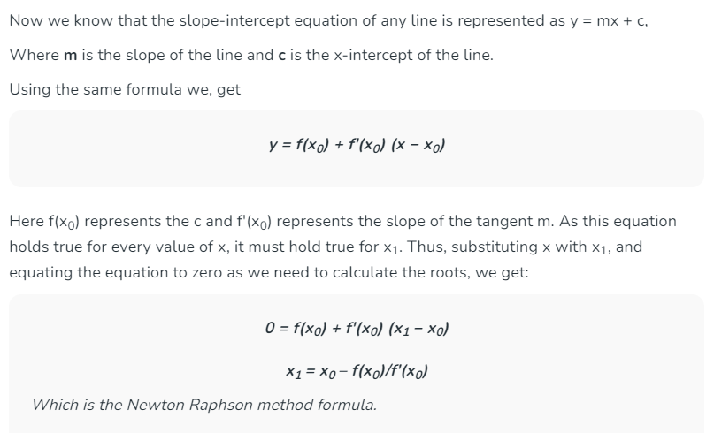

Slide 47
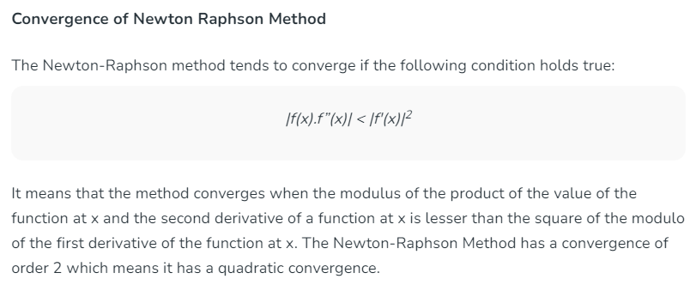

Slide 48
Nonlinear Steepest-Descent Method
The nonlinear steepest-descent method is based on a direct asymptotic analysis of the relevant Riemann–Hilbert problem; it is general and algorithmic in the sense that it does not require a priori information (anzatz) about the form of the solution of the asymptotic problem.
However, the noncommutativity of the matrix setting requires developing rather sophisticated technical ideas, which, in particular, enable an explicit solution of the associated local Riemann–Hilbert problem

Slide 49
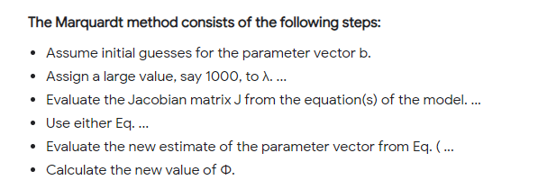
Marquardt’s methods

Slide 50
Semiparametric regression models
Semiparametric regression Deals with the introduction of some very general non-linear functional forms in regression analysis
Generally used to fit a parametric model in which the functional form of a subset of the explanatory variables is not known and/or in which the distribution of the error term cannot be assumed to be of a specific type beforehand.
Most popular semi parametric regression models are the partially linear models and single index models

Slide 51
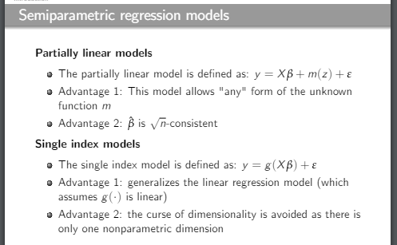

Slide 52
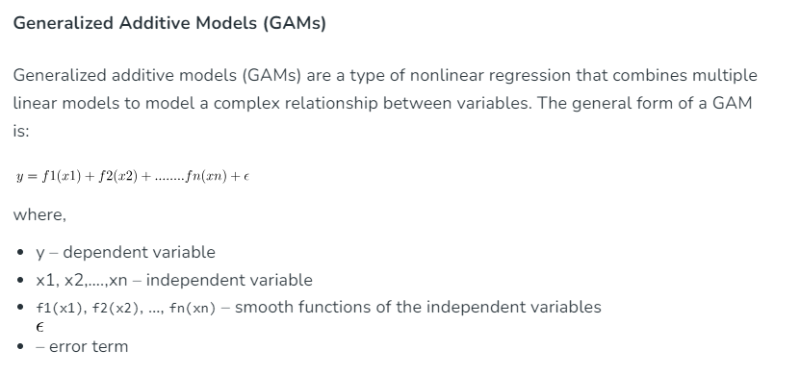

Slide 53
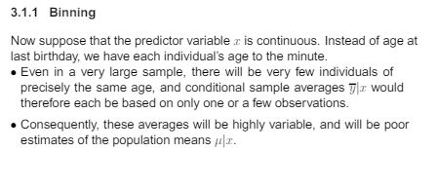

Slide 54
Common Nonparametric Regression Methods
Nonparametric regression is a set of regression techniques that do not assume a specific functional form for the relationship between the predictor variables and the target variable.
Instead, these methods are flexible and allow the data to determine the form of the relationship.
Nonparametric regression can capture complex, nonlinear relationships that might be difficult to model using traditional parametric methods.

Slide 55
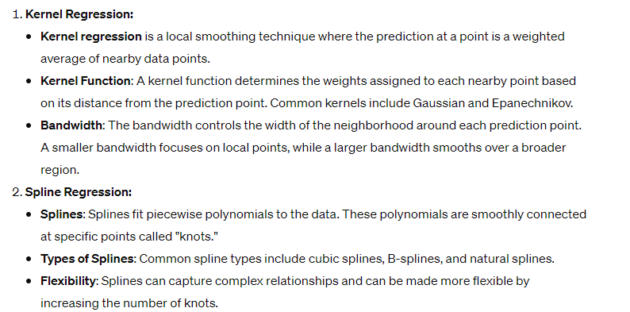
Common Nonparametric Regression Methods

Slide 56
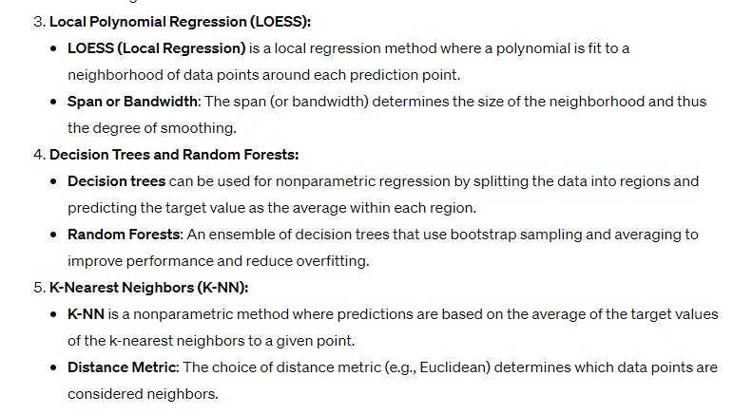

Slide 57
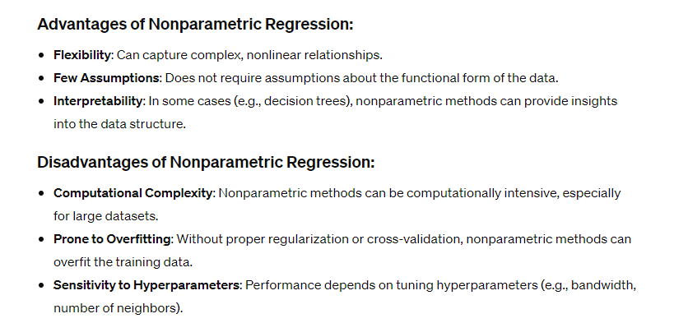

Slide 58
APPLICATIONS
1. Newton-Raphson Method
This method is a root-finding algorithm and is widely used in optimization problems where the objective is to find the root of the derivative of a function (minimizing or maximizing it).
Applications:
Regression Analysis:
  Used to fit non-linear models by minimizing the residual sum of squares.
Machine Learning Algorithms:
  Logistic regression and neural network training leverage the Newton-Raphson method for finding optimal weights.
Time Series Analysis:
  Estimation of parameters in ARIMA and other time-series models.
Optimization in Data Mining:
  Fine-tuning parameters of models to find the best fit.

Slide 59
2. Steepest Descent Method
Also called gradient descent, this iterative optimization algorithm minimizes functions by moving in the direction of the steepest decrease of the objective function.
Applications:
Training Machine Learning Models:
  Used extensively in linear regression, logistic regression, and deep learning to minimize the loss function.
Clustering Algorithms:
  Applied in optimizing centroids in k-means clustering.
Recommendation Systems:
  Finding optimal parameters in collaborative filtering methods.
Natural Language Processing (NLP):
  Optimizing word embeddings and other feature representations.

Slide 60
3. Marquardt Method (Levenberg-Marquardt Algorithm)
This method is a hybrid of the Newton-Raphson and Steepest Descent, often used in non-linear least squares optimization problems.
Applications:
Non-Linear Regression:
  Used to fit complex models where the relationship between variables isn't linear.
Neural Network Training:
  Specifically used for fine-tuning weights in small-scale problems where convergence speed is critical.
Curve Fitting in Predictive Analytics:
  Fitting curves to data points in scenarios like growth trends or population modeling.
Optimization in Image and Signal Processing:
  Used for parameter estimation in models applied to pattern recognition or feature extraction.

